Slide 1


Sudeep Lal Bajimaya

Slide 2
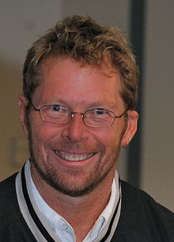
“Crystal is a family of human-powered, adaptive, ultra light, ‘stretch-to-fit’ software development methodologies.”
(Alistair Cockburn;http://alistair.cockburn.us/Crystal+methodologies.)

Slide 3
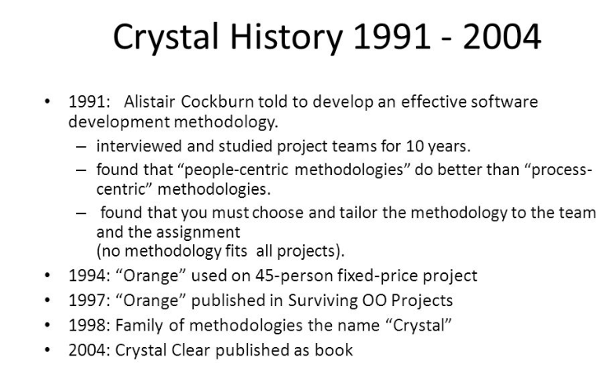

Slide 4
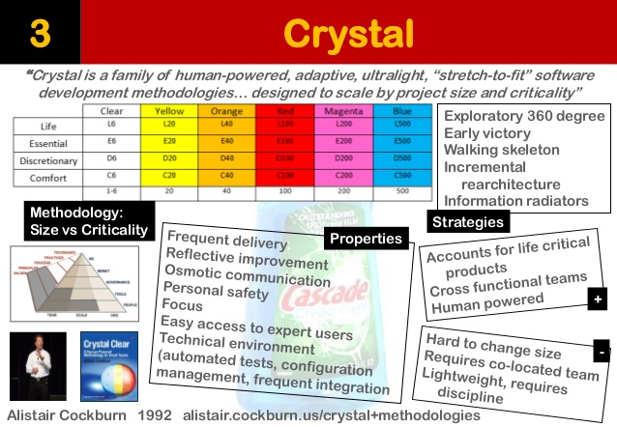

Slide 5
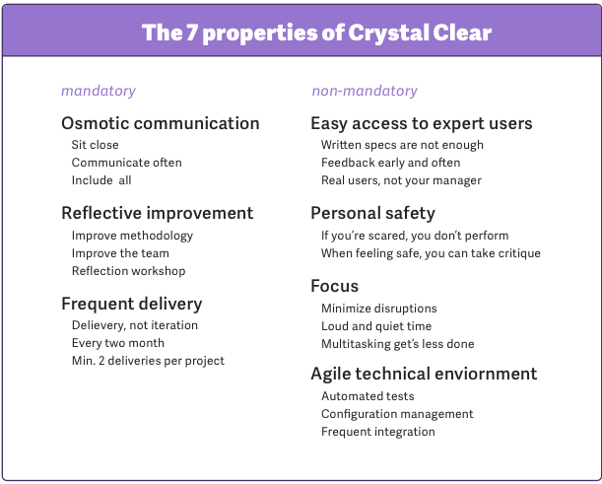

Slide 6
Crystal Family
4 level of criticality
C : Comfort (regular nominal.)
D : Discretionary money ( notional money)
E : Essential money (good amt of money)
L : Life (life critical)

Slide 7
Crystal Methodology
lightweight methodology using crystal clear. crystal yellow, crystal orang and other.
user team size, system criticality and priority of projects as various factors.
focuses on choosing the policies based on above factors.
focuses on the same tenants of agile.

Slide 8
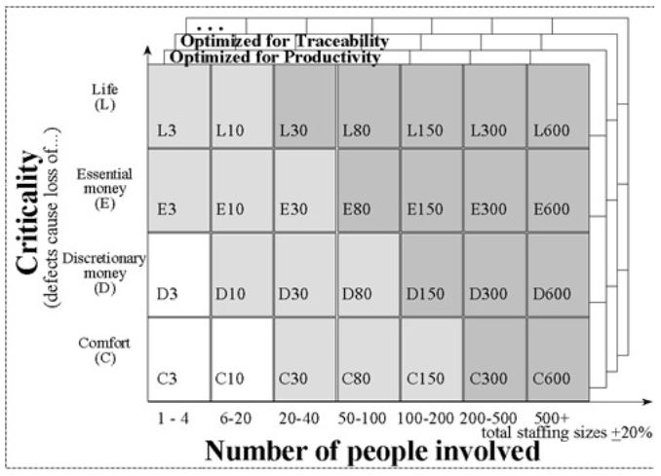

Slide 9
The Roles and their Work Products
Sponsor
Team as a Group
Coordinator
Business Expert & Ambassador User
Lead Designer
Designer-Programmers
Tester
Writer

Slide 10
The Sponsor is responsible for producing just one item:
the Mission Statement with Tradeoff Priorities.
The Team as a Group is responsible for producing two things:
the Team Structure and Conventions, and
the Reflection Workshop Results.
The Coordinator, with the help of the team, is responsible for producing
the Project Map,
the Release Plan,
the Project Status,
the Risk List,
the Iteration Plan & Status,
the Viewing Schedule.

Slide 11
The Business Expert & Ambassador User together are responsible for producing
the Actor-Goal List,
the Use Cases & Requirements File, and
the User Role Model.
The Lead Designer is responsible for producing the
the Architecture Description.
The Designer-Programmers (including the Lead Designer) are responsible for
the Screen Drafts,
the Common Domain Model
the Design Sketches & Notes,
the Source Code,
the Migration Code,
the Tests,
the Packaged System

Slide 12
The Tester (whoever is occupying that role at the moment) is responsible for
producing
the Bug Reports at that time.
The Writer is responsible for producing
the User Help Text.

Slide 13
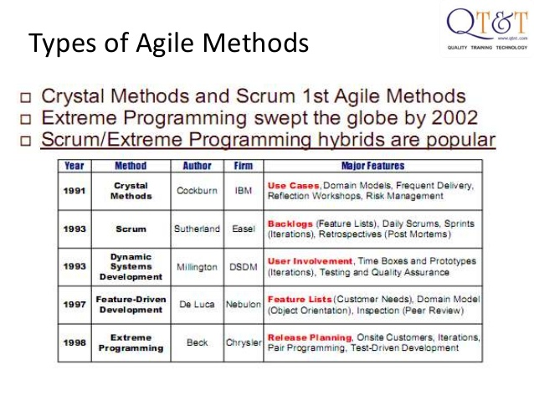

Slide 14
Reference and Bibliography
Cockburn, Alistair. (2004). Crystal clear a human-powered methodology for small teams.
http://www.versionone.com/Agile101/Agile-Development-Methodologies-Scrum-Kanban-Lean-XP/

